Slide 1
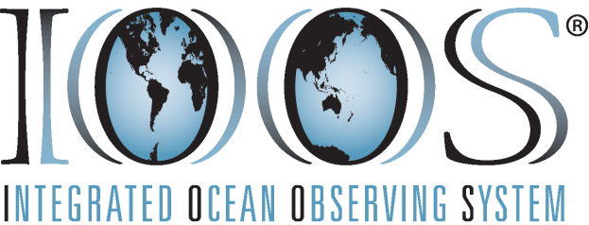
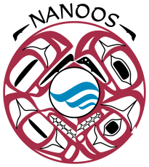
Graphic courtesy NOAA / PMEL / Center for Tsunami Research
Pacific Northwest Waters
Gateway to Our Future
Communication through the NANOOS Visualization System
Jonathan Allan
NANOOS User Products Chair

Slide 2
Why have a NANOOS visualization system?
Disparate suite of web sites available to the public (serving a wide range of data).
Regional needs: seamless delivery of coastal, estuarine and ocean data to stakeholders within the NANOOS domain
(+external partners, other RCOOS, and national/international programs).
NANOOS currently provides access to 47 different types of variables, and in total ~160 ‘assets’.
Effective delivery of these data and product feeds can lead to:
greater situational awareness (local and regional scales);
improved access to and understanding of environmental variables/conditions; and,
enable development and access to short- and long-term time-series.
Overall goal: to aid our understanding of climate variability, safety, operations, and lead to improved resource management and regional productivity.
Notes:
Without an integrated form of communication, finding and accessing these data would be a challenge for folks.
The challenge is how one measures success!

Slide 3
The Challenge - Many Stakeholders
State (e.g. ODFW, WADOE, DSL,…) and Federal agencies (NOAA, NWS, FEMA, US Coast Guard,...),
Cities and Counties
Ocean engineering (instruments, wave energy, telecommunication),
NGO’s,
Ports,
Bar pilots,
Fishers (recreational and commercial),
Shellfish growers,
Recreational boaters,
Tribes,
Geotechnical consultants,
Universities/researchers,
Schools (k-12),
Public-at-large,
and many others…

Slide 4
Methods of Communication
Needs to be seamless, accurate, of sufficient temporal and spatial resolution, and meets user needs;
Includes: portals, specific data/product page views, mobile applications, direct links, etc.
Key Requirements:
Interoperability with national-scale applications
Reliable, efficient ingest of data
Access to models, applications, tools and information products
A rich, yet simple (Google-maps) interface based around the following core functions:
current conditions;
forecasts; and,
access to historical data.

Slide 5
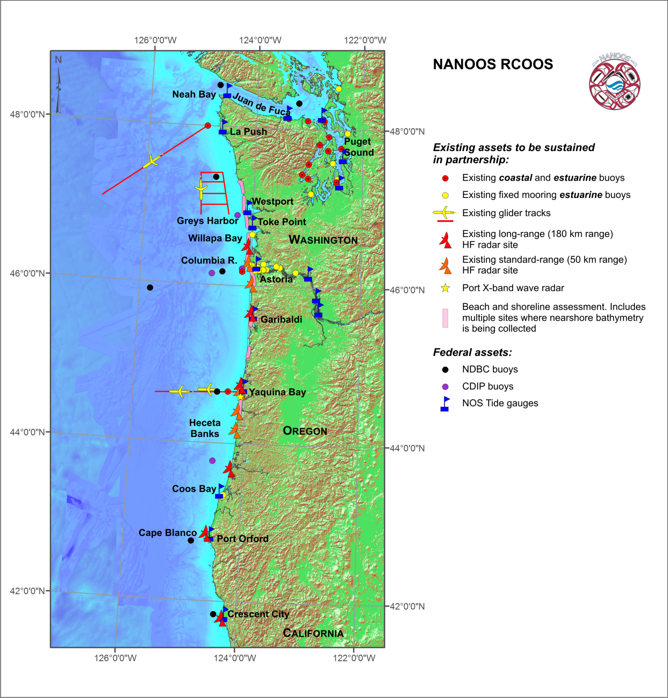
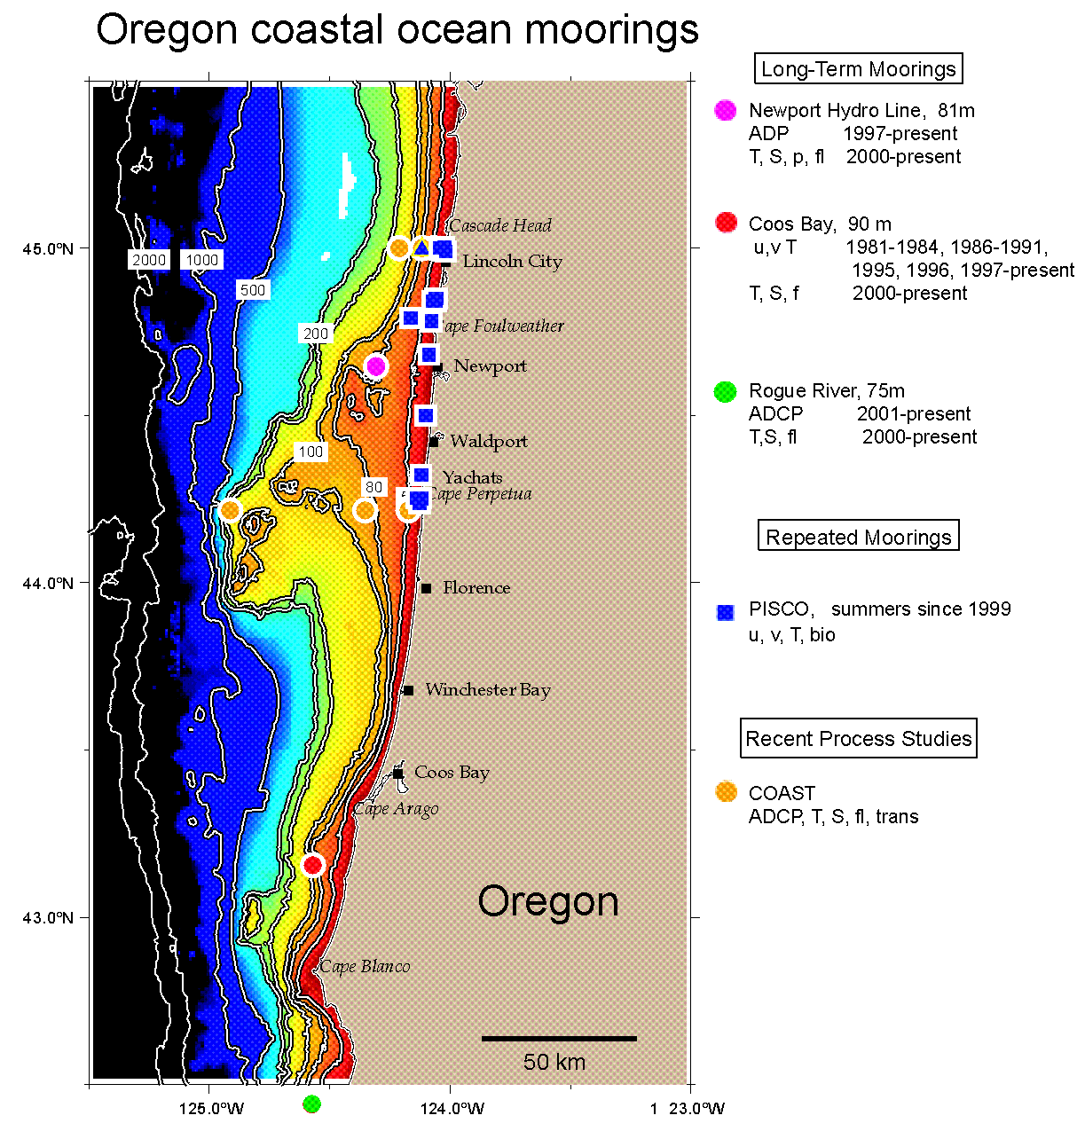
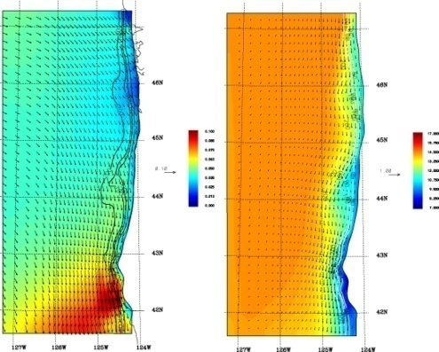
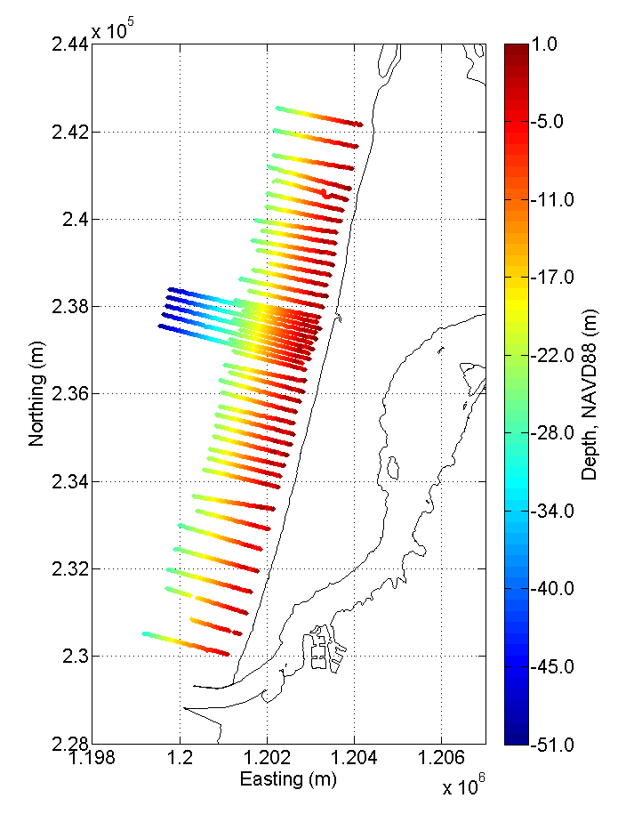
Shelf moorings & gliders
Overlays (Satellite, Models, & other geospatial data)
Shorelines & Bathymetry
Notes:
Core Data Components:
In situ sensors (estuary & shelf), HF & X-band radar, AUVs (gliders), ocean & estuarine circulation models, wave & meteorological models, satellite, coastal change and hazards.

Slide 6
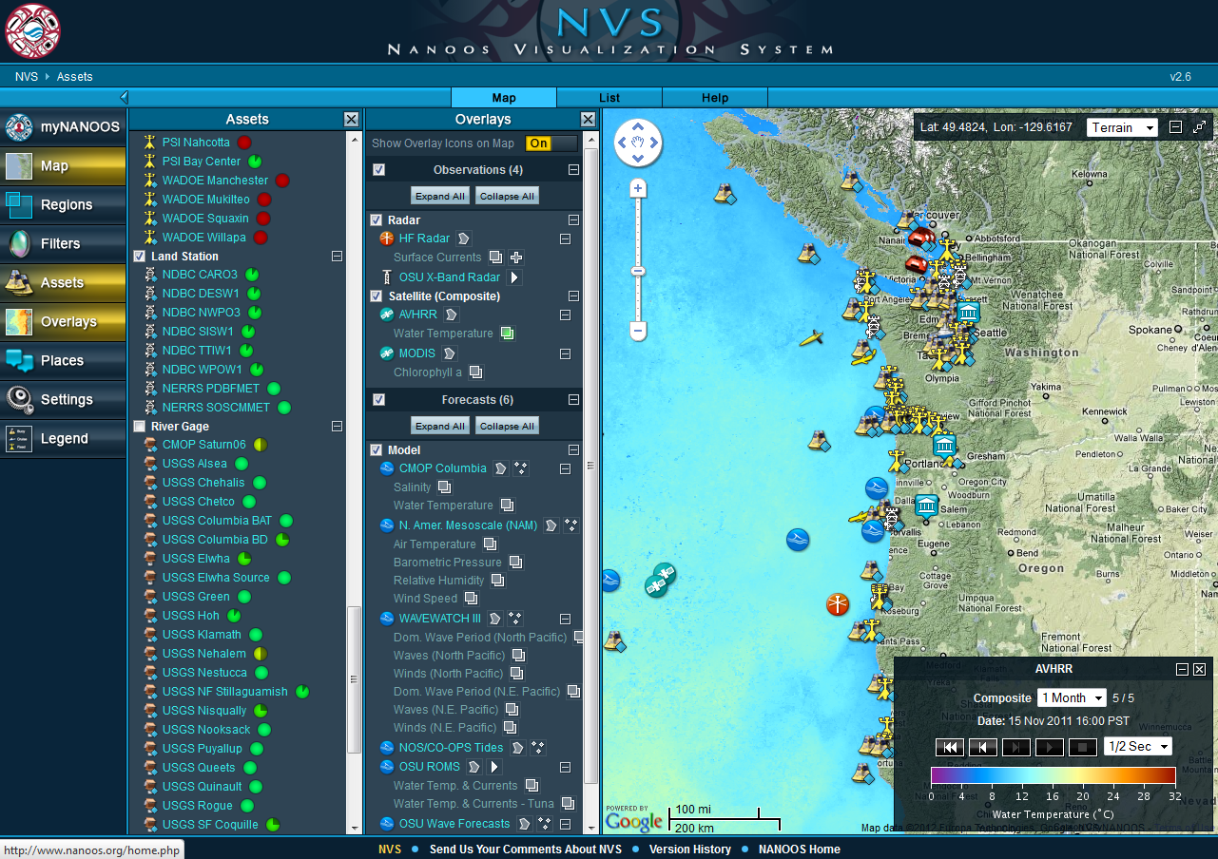
Notes:
Introduce NVS. Identify Assets, Overlays. Highlight example of water temperature overlay, which reflects a 1 month composite.

Slide 7
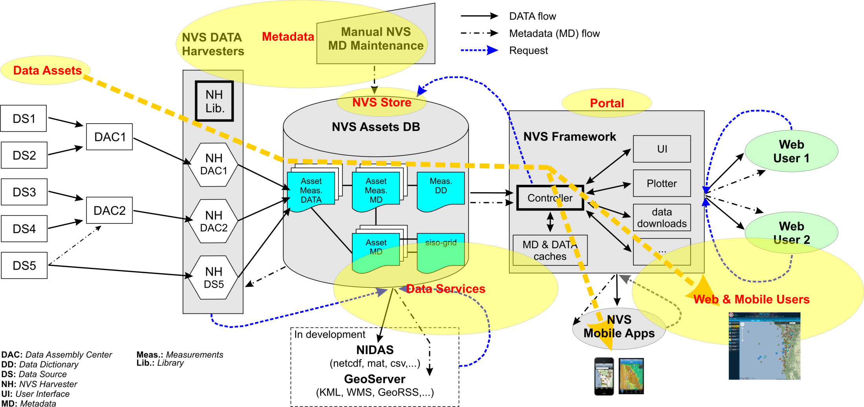
NANOOS Visualization System (NVS) Workflow

Slide 8
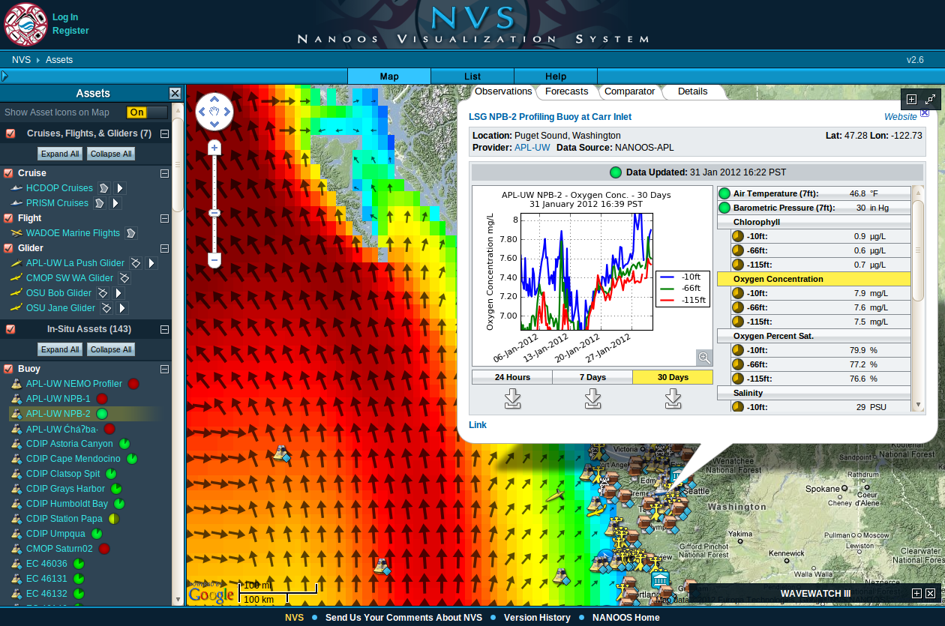
Notes:
Indicate asset list, eye-grabbing WWIII forecast overlay + vectors, time-series plot (dissolved Oxygen) showing multiple depths.
Variables listing has both weather and water sensors, and contrasts in the data-age icons, showing sensors with different sampling rates
This asset has a "Details" tab that you can use to assess asset-status.

Slide 9
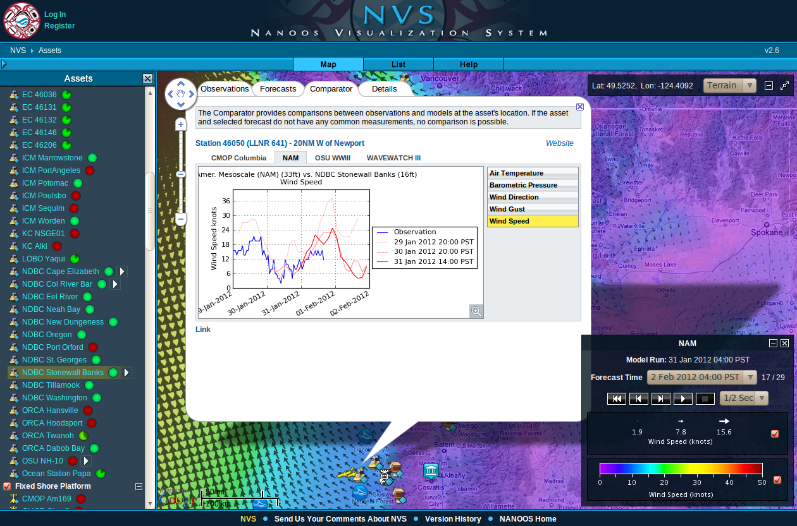
Notes:
It's a federal asset (previous asset was a "NANOOS", regional asset).
Data-model wind speed comparison is shown, for NAM winds.
The overlay in the background is also a NAM winds forecast, for late morning Feb 2nd (ie, around the time of your presentation).
You can point to forecasts from other models also being available, via the model tabs on the pop-up.

Slide 10
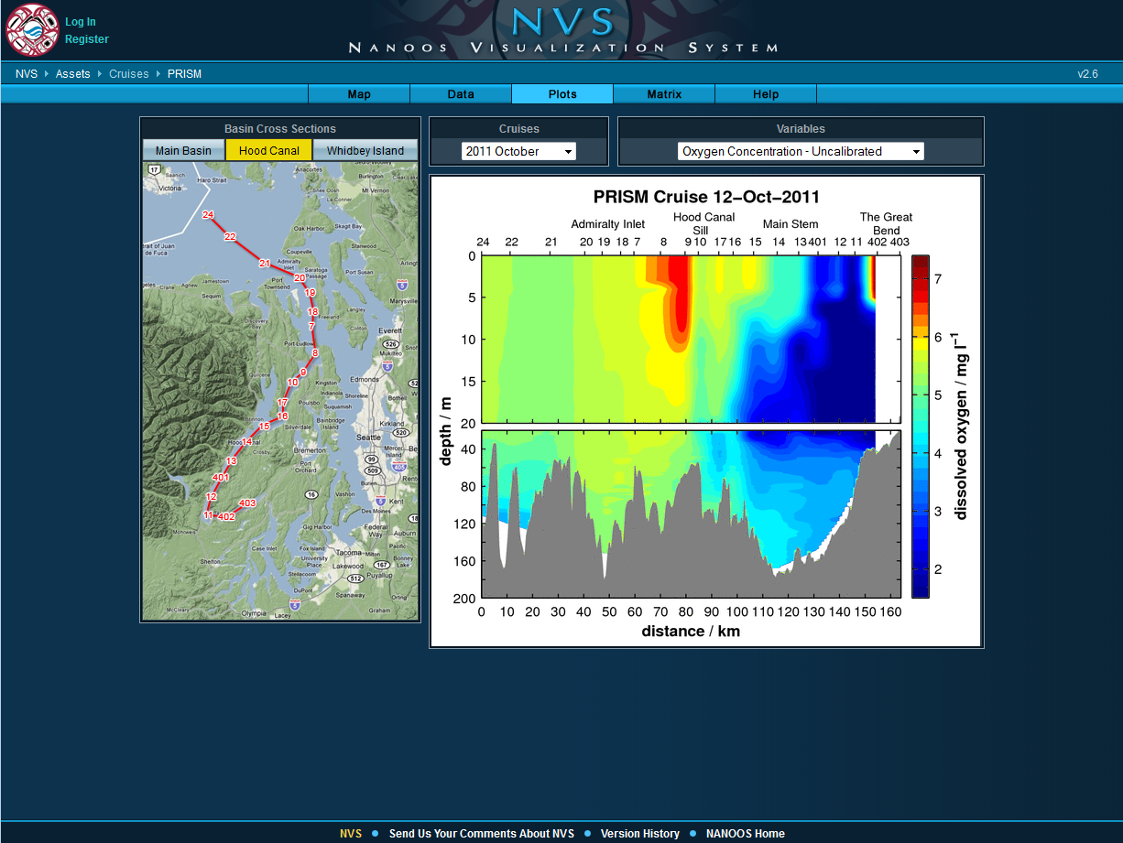

Slide 11
NANOOS Visualization Applications (NVAPs)
Beach and Shoreline Mapping Portal (Hazards, Climate) Washington coast data coming soon + plus bathymetry
Pacific Northwest Tsunami Evacuation Zones (Hazards) iPhone TsunamiNW-Evac app (v. 1.0, released Nov. 2011, Android Jan. 2012)
Maritime Operations Portal (Maritime Operations, Climate, Hazards, Fisheries) 1 km alongshore virtual nodes providing high resolution WWIII model time series, surface currents, etc. Under development
Situational Awareness Portal (All themes) Most recent observations providing situational awareness capability for multiple assets Under development
Others…
NANOOS Integrated Data Access System (NIDAS) (All themes) Access longer time series, user defined plots, etc. Under development
NANOOS/CMOP Data Explorer (All themes) Compare multiple variables and sites, user defined plots, etc. Under development

Slide 12
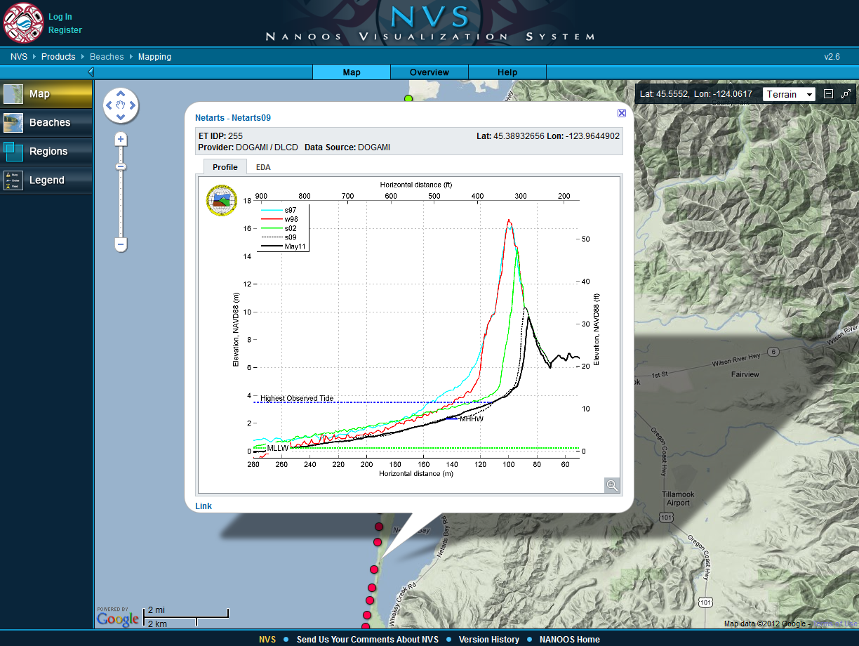

Slide 13
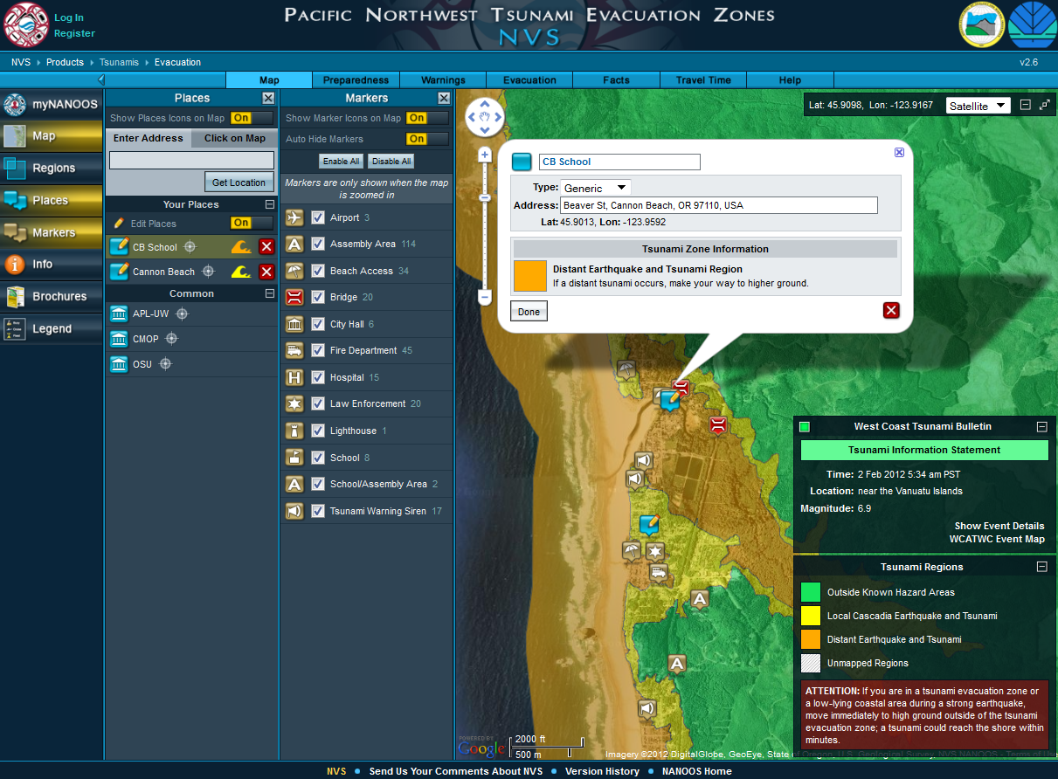

Slide 15
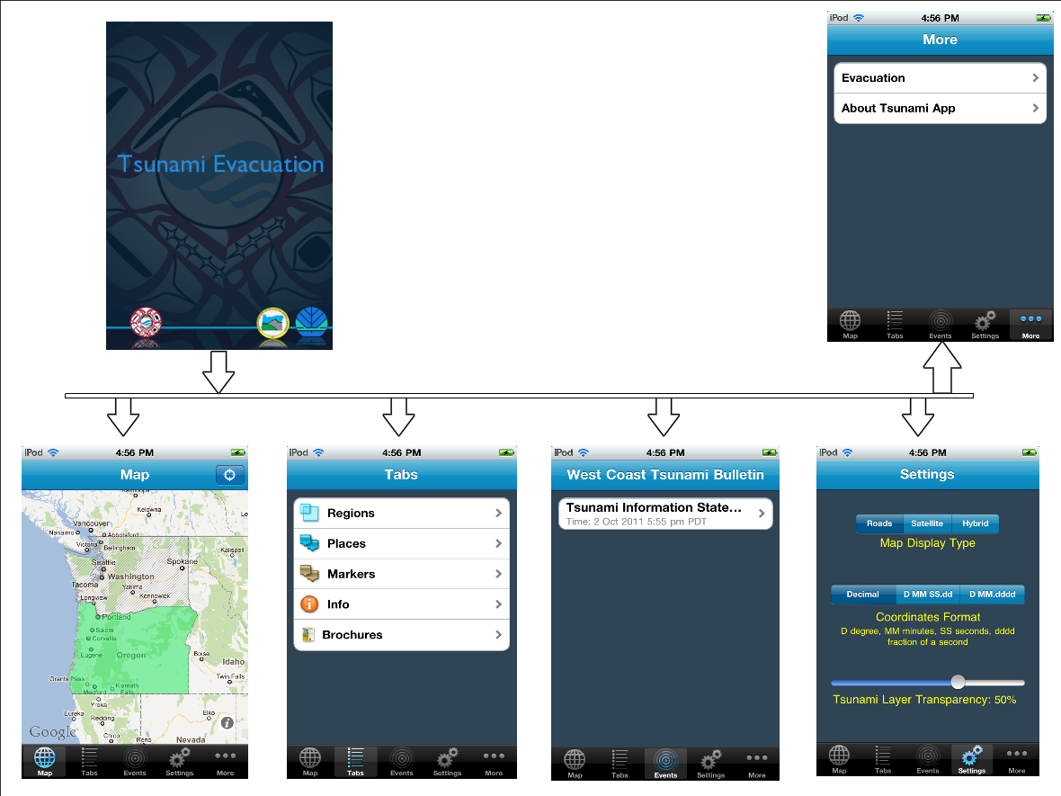
TsunamiNW-Evac
(iPhone/Android)

Slide 16
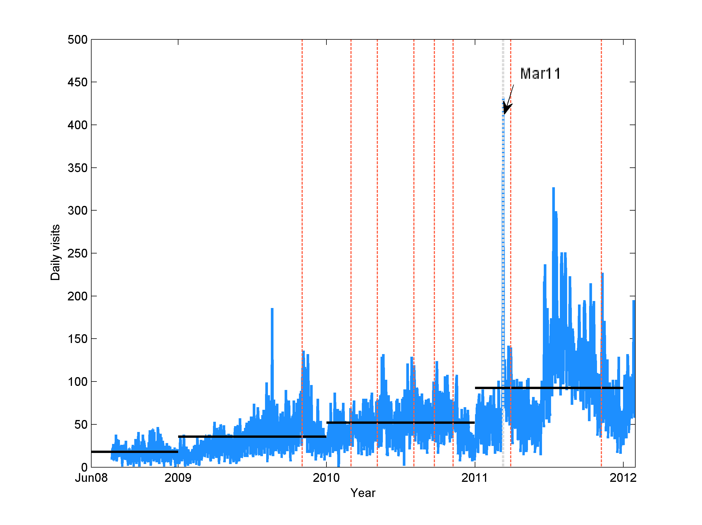
Usage Trends
Notes:
Plot showing time history of daily visits to the NANOOS site. Dashed red lines indicate times when NVS/mobile app updates have occurred. Black solid line indicates annual means.

Slide 17
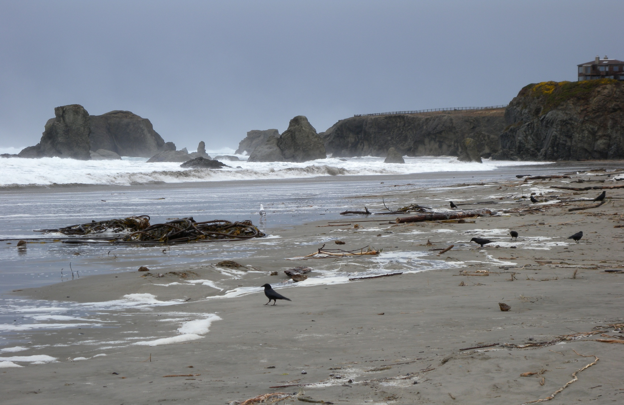
Questions?

Slide 18
NVS History and Status: Mar. 2010 - v1.5 released (added forecast capabilities, access to gliders and cruise data) May 2010 - v1.6 released (added access to various map image overlays e.g. HF radar, satellite imagery, and ocean models). v1.0 iPhone NVS mobile app released Aug 2010 - v2.0 released (added comparator (model vs measured time series) and forecast overlays). v1.0 Android NVS mobile app released Mar 2011 - v2.5 released (added MyNANOOS option, customized units and settings) Apr 2011 – v1.5 iPhone NVS released Jun 2011 - v. 2.0 iPhone NVS released (Android Sep 2011) Nov 2011 - v2.6 released (added Tsunami evacuation zones NVAP, and user created places) Nov 2011 - v. 1.0 iPhone TsunamiNW-Evac app released (Android Jan 2012)

